Slide 1
Manual BAC and IDOR hunting

Slide 2
Agenda
Why manual hunting?
What is manual hunting
BAC
Listing functions
Listing users
CRUD actions
Any other functions
GET calls
POST + PUT + DELETE calls
IDOR
Listing Objects
Listing users
RUD actions
Any other functions
GET calls
POST + PUT + DELETE calls

Slide 3
How to get support
If you need us for support, you can reach us by
ser@thexssrat.atlassian.net,
Just mail us, our system will do the rest
https://thexssrat.atlassian.net/servicedesk/customer/portal/4,
You can open a ticket

Slide 4
What is manual hunting
No tools but some do help
Manually either repeat call as other user
Or replace auth headers in calls via MiTM proxy
Theoretically, you can do this in firefox dev tools
Manually and individually verify each request

Slide 5
Why manual hunting?
It’s easy
It’s efficient
You can spot more details
It does take more time
You can individually judge parameters easier
For example 4 IDs in 1 request body
No tools required

Slide 6
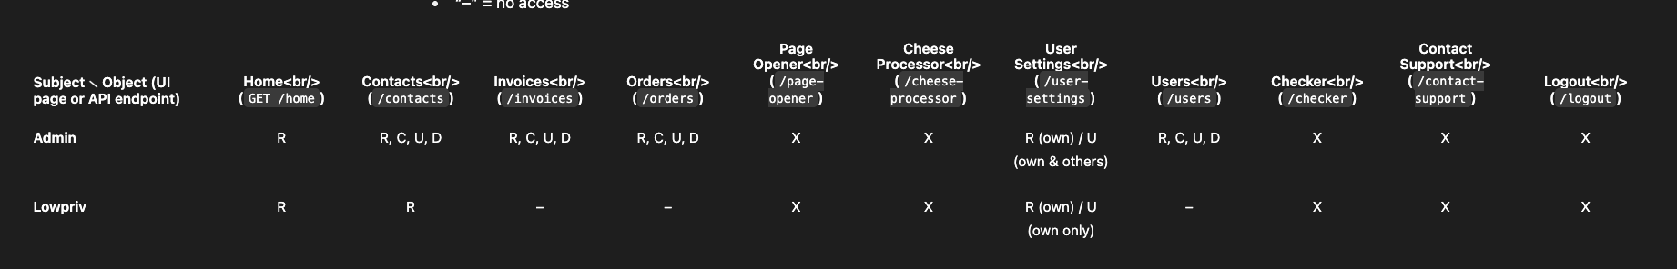
BAC - Listing functions + users
https://labs.hackxpert.com/Testing%20grounds/ratsite/index.php
Users: lowpriv;lowpriv and test;test (admin)

Slide 7
BAC - CRUD actions
And now we make test cases

Slide 8
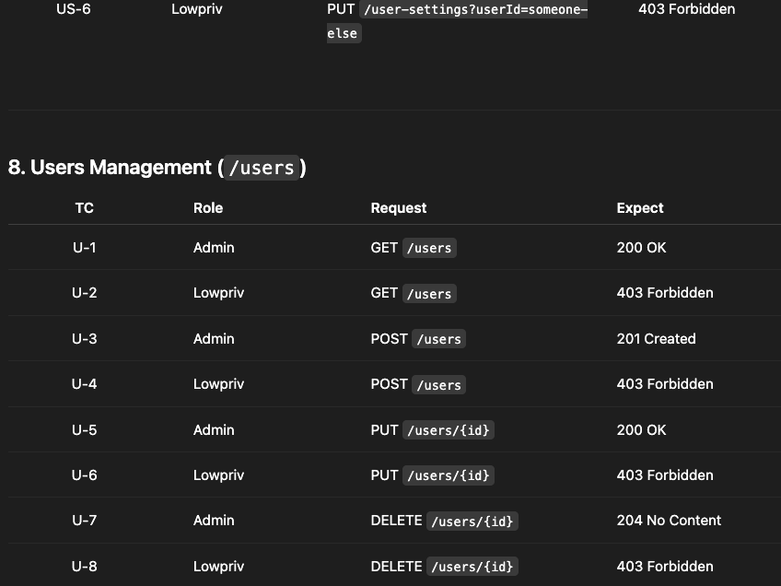
BAC - CRUD actions
And now we make test cases

Slide 9
BAC - CRUD actions
And now we make test cases
We gotta shrink this down! No use in testing 200 OK test cases or admin cases!

Slide 10
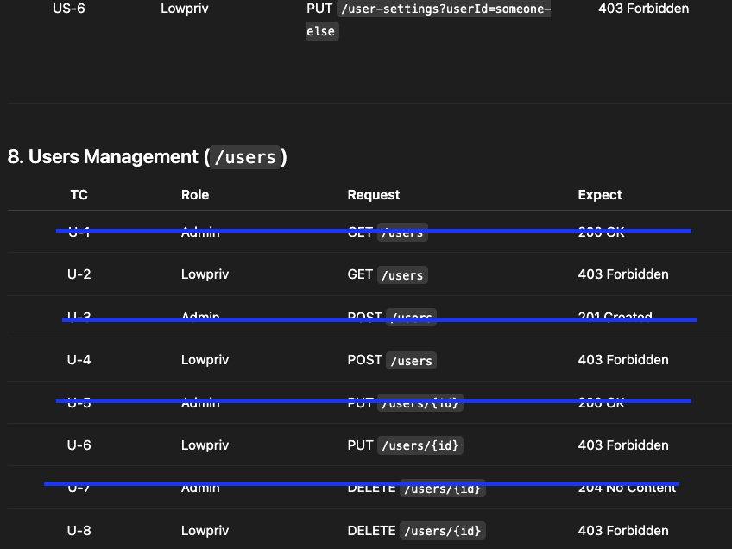
BAC - CRUD actions
And now we make test cases
We gotta shrink this down! No use in testing 200 OK test cases or admin cases!

Slide 11
BAC - CRUD actions
POST /contacts – lowpriv tries to create a contact
PUT /contacts/{id} – lowpriv tries to update any contact
DELETE /contacts/{id} – lowpriv tries to delete any contact
GET /invoices – lowpriv tries to view the invoices listing
POST /invoices – lowpriv tries to create a new invoice
GET /orders – lowpriv tries to view the orders listing
POST /orders – lowpriv tries to create a new order
GET /user-settings?userId={otherUser} – lowpriv tries to view another user’s settings
PUT /user-settings?userId={otherUser} – lowpriv tries to update another user’s settings
GET /users – lowpriv tries to list all users
POST /users – lowpriv tries to create a new user
PUT /users/{id} – lowpriv tries to update any user
DELETE /users/{id} – lowpriv tries to delete any user

Slide 12
BAC - CRUD actions
GET /users – lowpriv tries to list all users
POST /users – lowpriv tries to create a new user
PUT /users/{id} – lowpriv tries to update any user
DELETE /users/{id} – lowpriv tries to delete any user

Slide 13
BAC - GET calls
You log in to the browser as administrator
You log in to a different browser (firefox vs chrome) or in private mode as low priv
You copy the link from the admin window
You paste it into the lowpriv user
We can clearly see the user should not have access to this in the next screenshot in the right

Slide 14
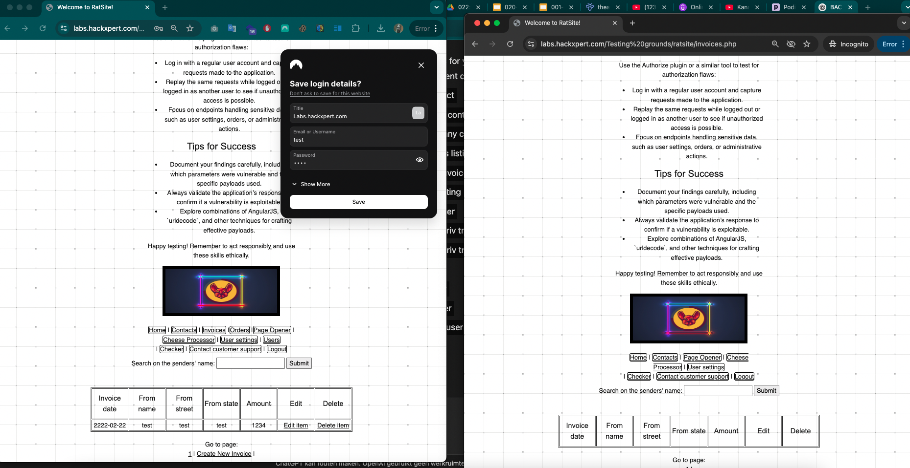
BAC - GET calls
You log in to the browser as administrator
You log in to a different browser (firefox vs chrome) or in private mode as low priv
You copy the link from the admin window
You paste it into the lowpriv user

Slide 15
BAC - POST/PUT/DELETE calls
Easiest way: MiTM proxy
Open burp
Open browser
Log in as low priv user in incognito
Log in as admin in normal browser
Make a request (click around) as the low priv user
Capture their auth headers
In ratsite: PHPSESSIONID
Save it somewhere
Make a request (click on something high priv user can not do)
Send the request to repeater
Replace the auth header

Slide 16
IDOR - Listing objects
Instead of functions we list all the objects that are private
Public objects we do not care about
Ratsite
Invoices
Orders
Contacts
Do not forget: Users

Slide 17
IDOR - Listing users
User A (admin)
User B (admin)
Both should have rights to the objects but only their own!

Slide 18
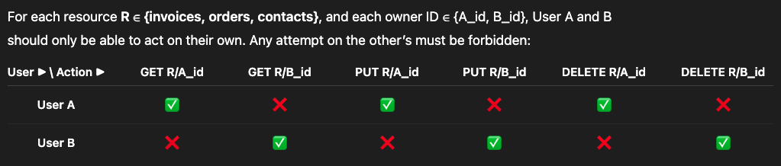
IDOR - RUD actions

Slide 19
IDOR - RUD actions
User A – GET /invoices/B_id → 403 Forbidden
User A – PUT /invoices/B_id → 403 Forbidden
User A – DELETE /invoices/B_id → 403 Forbidden
User A – GET /orders/B_id → 403 Forbidden
User A – PUT /orders/B_id → 403 Forbidden
User A – DELETE /orders/B_id → 403 Forbidden
User A – GET /contacts/B_id → 403 Forbidden
User A – PUT /contacts/B_id → 403 Forbidden
User A – DELETE /contacts/B_id → 403 Forbidden

Slide 20
IDOR - GET calls aka READ
Just do the same method of
Logging into two browsers
One user A
One user B
Copy the link of resource
Paste it in other users browser
Should return 403
Do this for ALL resources that should be PRIVATE

Slide 21
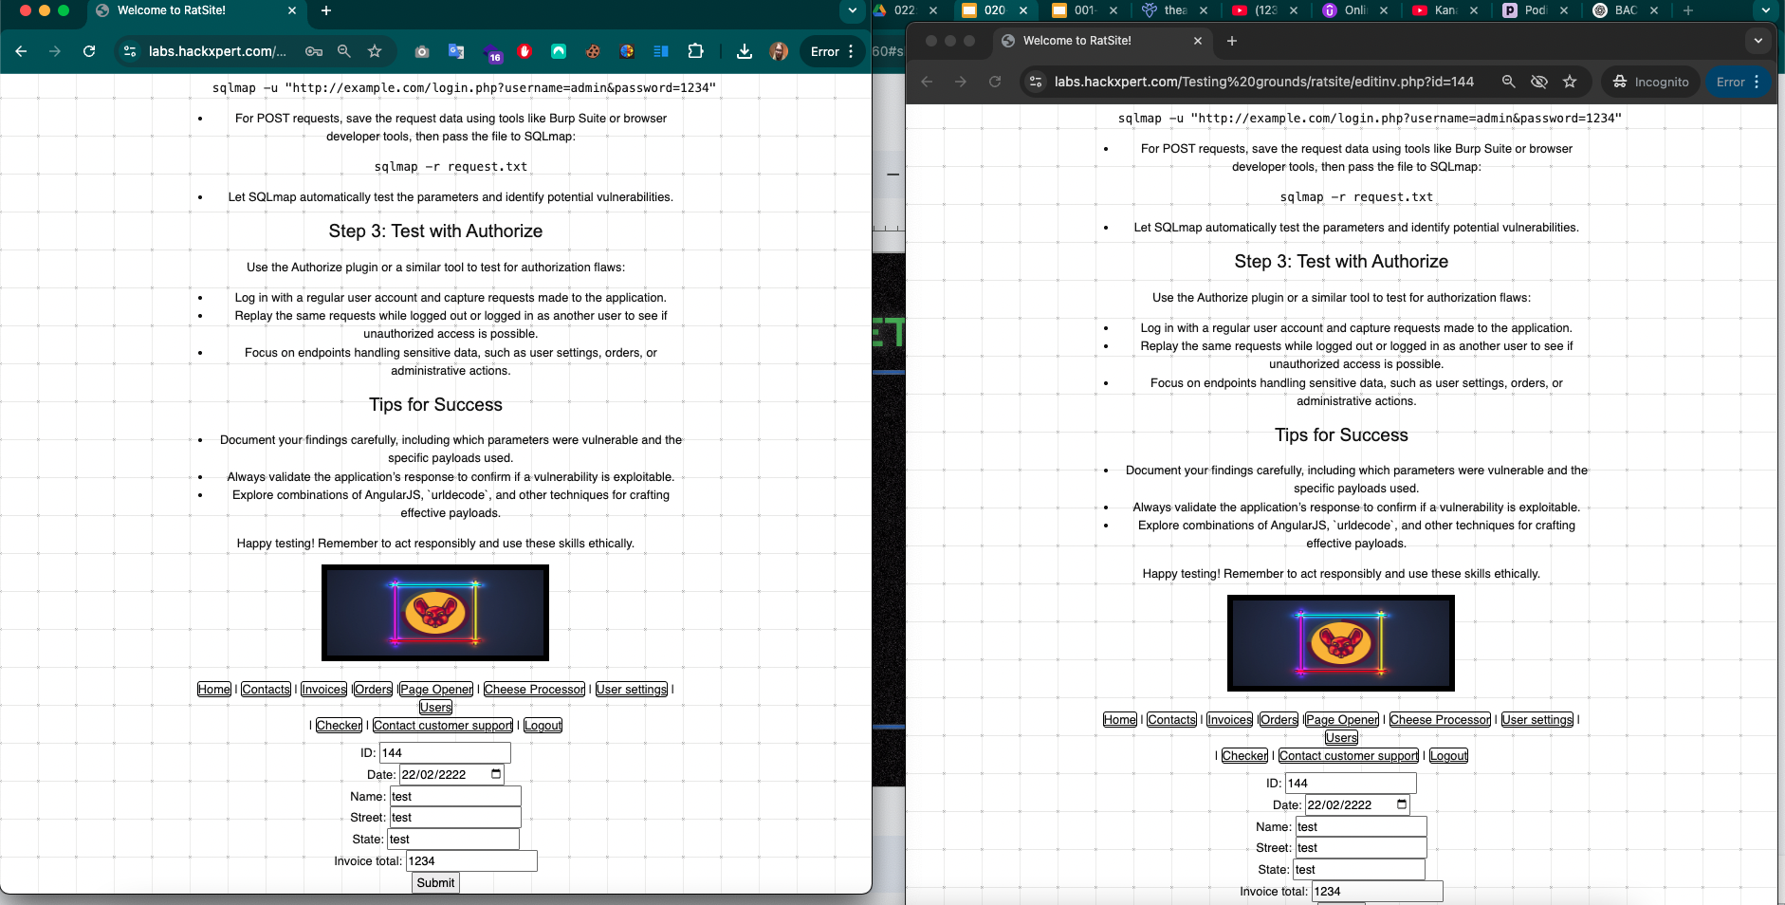
IDOR - GET calls aka READ
Just do the same method of
Logging into two browsers
One user A
One user B
Copy the link of resource
Paste it in other users browser
Should return 403

Slide 22
IDOR - POST + PUT + DELETE calls
Easiest way: MiTM proxy
Open burp
Open browser
Log in as A user in incognito
Log in as B in normal browser
Make a request (click around) as the A
Capture their auth headers
In ratsite: PHPSESSIONID
Save it somewhere
Make a request as B on a PRIVATE object (Update/Delete)
Send the request to repeater
For DELETE calls MAKE SURE YOU INTERCEPT AND REPLACE AS YOU CAN NOT DELETE TWICE!
Replace the auth header

